Slide 1
Piano Hero
A Learning Game for my Final Project
Solo Team: Daniel Mendelsohn

Slide 2
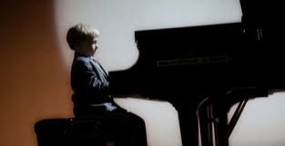
Teaching kids an instrument is hard

Slide 3
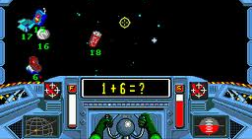
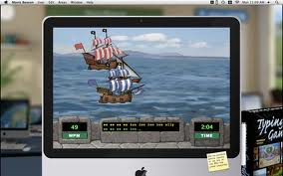
Games help kids learn
Math Blaster
Mavis Beacon Teaches Typing

Slide 4
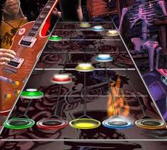
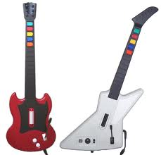
Music games are commercially successful

Slide 5
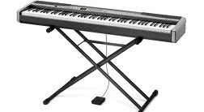
Moving away from a “toy” controller

Slide 6
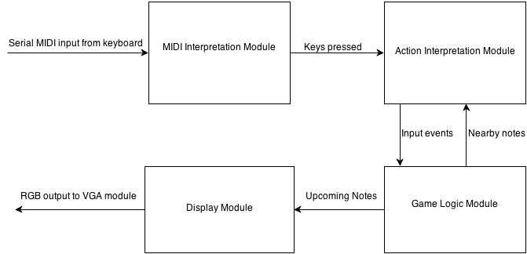
A block diagram for a commercial product

Slide 7
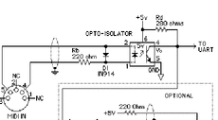
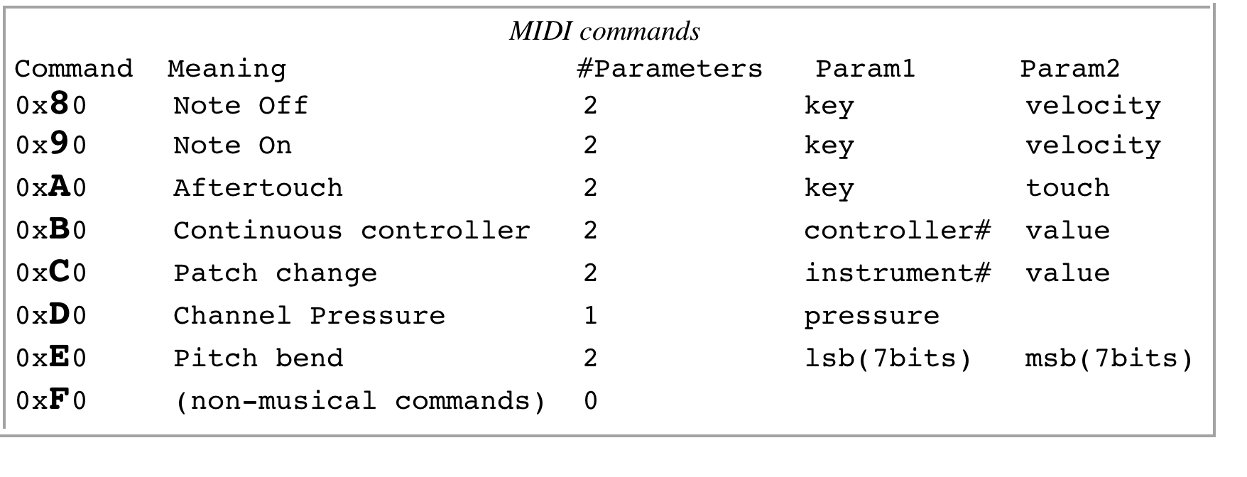
MIDI is a sensible lightweight protocol

Slide 8
A block diagram for a commercial product

Slide 9
The game logic block reads data controls game state
Data stored in a lightweight format in RAM
Internal “atomic” clock for smallest possible time subdivision (~50ms)
Passes relevant information to specialized blocks

Slide 10
A block diagram for a commercial product

Slide 11
Action interpreter interfaces between game logic and parsed user input
Gets input from game logic – what notes should be played and when
Gets input from MIDI interpreter – what notes user is playing and when
Determines if user action matches the correct action based on internal game data
Lots of little design decisions w/ regards to input

Slide 12
A block diagram for a commercial product

Slide 13
A display module drives the VGA output

Slide 14
Insight: reusable sub-modules
Example: “NxM” buffer
A NxM buffer takes in blocks of size M as input.
It can hold N such blocks
An input signal triggers data clearing
An output signal indicates data overflow

Slide 15
Timeline
Week of 11/18: Build a working minimum viable product for each block
Week of 11/25: Debug and adjust the individual blocks
Week of 12/2: Integration and user testing
If there is time: Fun augmentations. For example, a “learning” mode in which you can play a tune and thus “create your own level”

